Slide 1
Anxiety and BNST Peptides – An Introduction
Bed Nucleus of the Stria Terminalis - defined
What is Anxiety?

Slide 2
What is the BNST?
Bed Nucleus of the Stria Terminalis
A nucleus (group of neuronal soma)
emBedded at the end (Terminal) of white matter projection pathway
i.e. nucleus at the end of the stria terminalis
Part of the Extended Amygdala

Slide 3
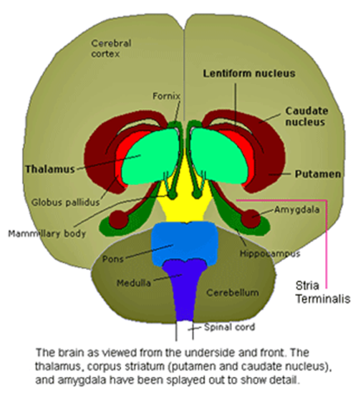
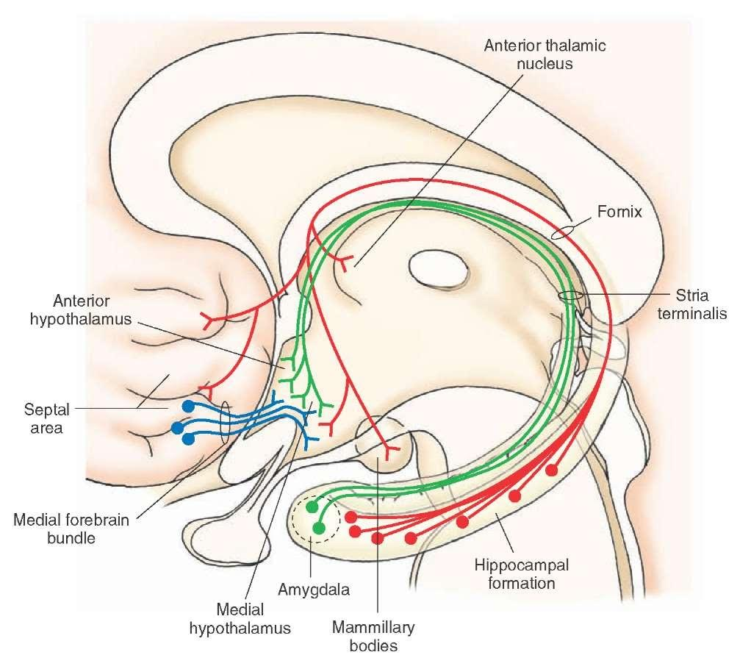
What is the Stria Terminalis?
Axonal Pathway from the Amygdala
To the BNST
Runs parallel to the Fornix
From the Hippocampus
From corticomedial Amygdala
C-shape around Thalamus
Some fibers to Nucleus Accumbens
BNST

Slide 4
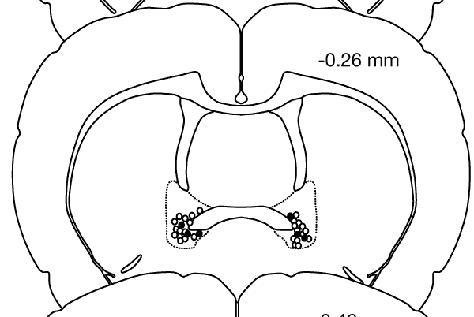
Where is the BNST?
Anterior Commissure
Medial to ventricle
Striatum internal
Septum capsule
Amygdala
At the level of the
Basolateral Amygdala
(BLA)
Ant Comm

Slide 5
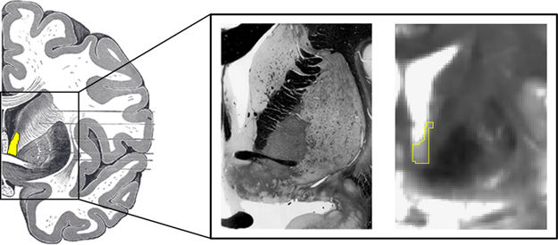
Where is the BNST?
Posterior to
Nucleus Accumbens
Anterior to
Thalamus
Hypothalamus
Ventral to Septum

Slide 6
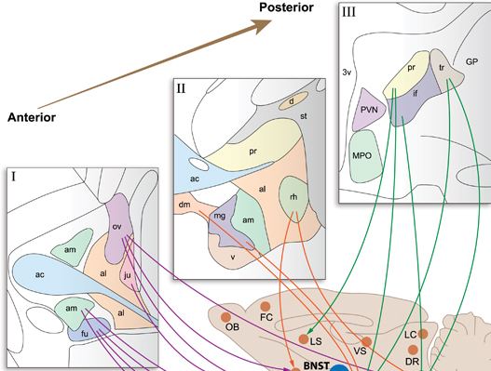
BNST Structure
Division: Position | Anterior nuclei | Posterior nuclei
Above AC | Anteromedial (am) Anterolateral (al) Oval (ov) Juxtacapsular (ju) Principle (pr) | Principle Transverse (tr) Interfascicular (if)
Below AC | Anteromedial, Fusiform (fu) Anterolateral, Dorsomedial (dm) Magnocellular (mg) Ventral (v) Rhomboid (rh)
Size (18 subregions)
small sunflower seed
¹/₁₀th size of amygdala

Slide 7
Neuropeptides produced in the BNST
Angiotensin 2
Arginine Vasopressin (AVP)
Cholecystokinin (CCK)
Corticotropin Releasing Factor (CRF)
Dynorphin (Dyn)
Enkephalin (Enk)
Local BNST Receptors
-
Oxt_{1A}
-
CRF₁ CRF₂
κOR μOR
δOR μOR

Slide 8
Neuropeptides produced in the BNST
Galanin (Gal)
Neurokinin B (NK_{B})
Neuropeptide Y (NPY)
Neurotensin (NT)
Pituitary AC activating polypeptide (PACAP)
Somatostatin (Sst)
Local BNST Receptors
-
NK₃
Y₁ Y₂ Y₄ Y₅
-
PAC₁
-

Slide 9
Neuropeptides and other Neuromodulators produced in the BNST
Substance P (SP)
Vasoactive Intestinal Peptide (VIP)
Calbindin (CaB)
Calretinin (CR)
Nociceptin
Endocannabinoids
2 arachidonoylglycerol (2-AG) and/or anandamide (AEA)
Local BNST Receptors
(NK₃)
PAC₁
-
-
-
Cb₁

Slide 10
Neuromodulators projecting to the BNST
Androgens (T, DHT)
Estrogens (E₂)
Progesterone (P)
Dopamine (DA)
Serotonin (5-HT)
Norepinephrine (NE)
BNST Receptors
AR
ER
PR
D₁ D₂
5-HT_{1A}
α₁ α₂ β₁ β₂

Slide 11
Afferent projections to the BNST
From:
Olfactory Bulb
PFC (FC = frontal cortex)
Amygdala (Amy)
Septum (LS + VS)
Hypothalamus
Raphé
Locus Ceruleus (LC)
Ventral Tegmental Area (VTA)
N. Solitary Tract (NTS)

Slide 12
Major inputs to the BNST
Central Amygdala (CeA) to al = GABA
CeA to al, am, fu = CRF
Medial Amygdala (MeA) to pr = GABA
Infralimbic PFC to fu and dm = Glu
Hippocampus to pr = Glu
LC to dm, al = NE
VTA to dm, al = DA
Dorsal Raphé (DR) to al, ov, dm = 5-HT

Slide 13
Efferent projections from the BNST
To:
Amygdala
(from ov, ju, am, fu, rh)
Hypothalamus
(from ov, am, fu, dm, mg, pr, if) Septum (from pr)
VTA (from pr, tr, rh, ov)

Slide 14
Hormone-related projections to HPA Axis from the BNST
Hypothalamus
CRF cells
in the mpPVN (medial parvocellular Paraventricular Nucleus)
Inhibited by GABA
from am, fu, ov,
pr, if
Stimulated by Glu

Slide 15
Anxiety
Can you see it in their faces?

Slide 16
So… What is Anxiety?
From External Sources?
Self Created?

Slide 17
Anxiety is Related to Stress
Always related to Neuroendocrine Stress Responsiveness
Is expressed on an Intensity Gradient
Is highly Comorbid with other Affective Disorders

Slide 18
Anxiety is stimulated by specific Neurochemicals
CRF – CRF₁ receptors
Orexin (Orx) - Orx₁ receptors
NE – α₁ receptors
5-HT – 5-HT_{2C} receptors

Slide 19
Anxiety is inhibited by specific Neurochemicals
CRF – CRF₂ receptors
Orexin (Orx) – Orx₂ receptors
NE – α₂ receptors
Neuropeptide Y (NPY)– Y₁₋₅ receptors
Neuropeptide S (NPS)– NPS receptors
GABA – GABA_{A} receptors

Slide 20
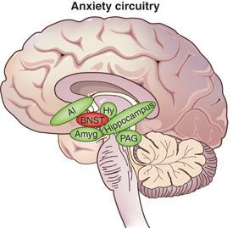
Anxiety is stimulated via specific Brain Regions
Amygdala – CeA and BLA
BNST- Find out in this seminar?
Locus Ceruleus
Hypothalamus – LH-DMH/PeF, PVN
Anterior Insula
Periaqueductal Gray (PAG)

Slide 21
Definitions must be carefully constructed
This one works for predators but not rivals

Slide 22
Conclusions
Anxiety derives from stress-related neurocircuitry
Includes the Extended Amygdala
Includes the BNST
BNST is a part of the Limbic System
Contains Anxiety-related Neuromodulators
CRF: CRF₁, CRF₂
NPY: Y₁, Y₂, Y₄, Y₅
GABA: GABA_{A}

Slide 23
Conclusions
BNST has Anxiety-related input
Anxiogenic Receptors
α₁ (NE)
Orx₁ (Orexin = Orx)
Anxiolytic Receptors
Cb₁ (endocannabinoids 2-AG and/or AEA)
5-HT_{1A} (serotonin = 5-HT)
Orx₂ (Orexin = Orx)
α₂ (NE)

Slide 24
Wow – SAM for sale
Mouse Model $1790
Rat Version $1990
https://mazeengineers.com/portfolio/stress-alternatives-model-maze/

